Slide 1
Our Solar System
Astronomical Facts and figures

Slide 2
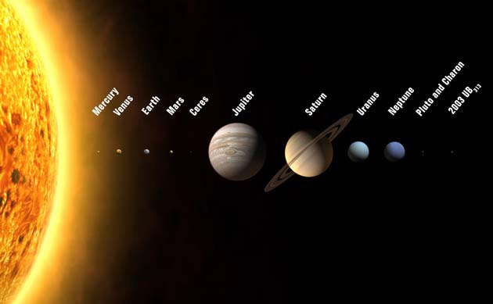
We are Here!

Slide 3
Jargon Buster – Which is Which? Number the definitions
A large mass at the centre of a solar system that produces heat and light……………..
A cluster of billions of stars, held together by gravity……………..
Gravitational Force per unit mass. Measured in newtons per kg……………..
The force of attraction between all objects……………..
The force acting on an object due to the pull of gravity. Measured in Newtons……………..
The amount of matter an object contains. Mass is measured in 'kg'……………...
The time taken for a planet to turn once on its axis. ……………..
The time taken for a planet to complete one orbit of its star…………….
The distance travelled by light in one year…………….
Sub-atomic particles and anything made from them, such as atoms and molecules…………….
The path of an object as it revolves round another body. One complete revolution of an object………
A celestial body or man-made object that orbits a planet or a star…………….
A large ball of matter that orbits a star. It does not emit light itself…………….
A lump of matter that orbits a planet…………….
A celestial body bigger than 10m orbiting the sun generally between Mars and Jupiter…………….
A chunk of ice and rock originating in the outer solar system, often accompanied by a coma and a tail…………….
A streak of light seen when a space rock enters the atmosphere and starts burning up…………….
A system of planets or other bodies orbiting a star…………….
The galaxy that contains our solar system…………….
A person trained to travel beyond the earth’s atmosphere…………….
Solar System
Star
Planet
Moon
Galaxy
Milky Way
Satellite
Comet
Meteor
Asteroid
Orbit
Gravitational Field Strength
Weight
Mass
Matter
Light year
Day
Year
Gravity
Astronaut

Slide 4
Astronomical Facts and Figures : Use the data to complete the following slides
 | Distance in millions of | Length of 1 year | Length of 1 day | Diameter at | Circumference | Satellites | Rings | Rotation | Surface temp | Gravity
 | kilometers from the sun |  |  | equator km | km |  |  |  | Celcius | N/Kg
Mercury | 69.7 - 45.9 (58) | 88 earth days | 59 earth days | 4,878 | 15,326 | 0 | 0 | W to E | 350 | 3.7
Venus | 109 -107.4 (108) | 225 earth days | 243 earth days | 12,104 | 38,025 | 0 | 0 | E to W | 480 | 8.9
Earth | 152.1 - 147.1 (150) | 365.26 earth days | 23h 56m | 12,755 | 40,071 | 1 | 0 | W to E | 22 | 9.8
Mars | 249.1 - 206.7 (228) | 687 earth days | 24h 37m | 6,790 | 21.331 | 2 | 0 | W to E | -23 | 3.7
Jupiter | 815.7 -740.9 (778) | 11.9 earth years | 9h 56m | 142,796 | 448,665 | 16 | 1 | W to E | -150 | 23
Saturn | 1,507 - 1,347 (1430) | 29.5 earth years | 10h 14m | 120,660 | 379,113 | 20 | thousands | W to E | -180 | 9
Uranus | 3,004-2,735 (2870) | 84 earth years | 17h 14m | 51,118 | 160,612 | 15 | 11 | E to W | -210 | 8.7
Neptune | 4,537 - 4,456 (5400) | 164.8 earth years | 16h 3m | 49.528 | 155,610 | 8 | 5 | E to W | -220 | 11

Slide 5
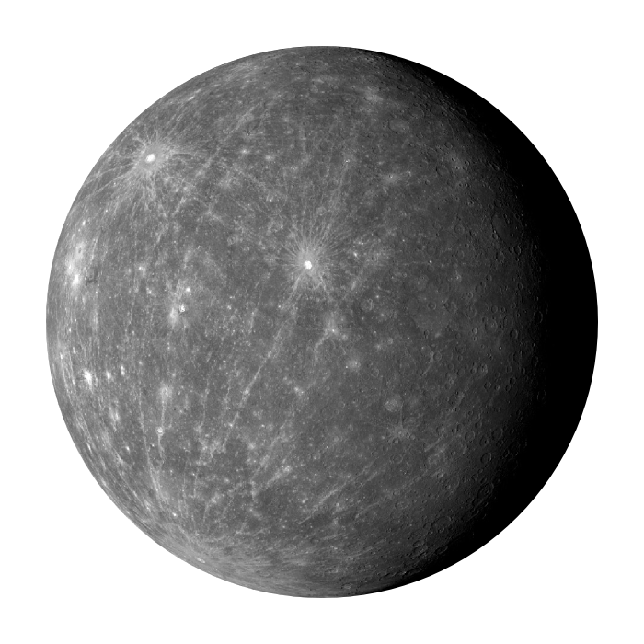
Mercury | Facts
Distance from the Sun (Millions of Kilometres)
Length of 1 year
Length of 1 day
Diameter at the Equator
Circumference
Satellites
Surface Temperature
Gravity
Rotation

Slide 6
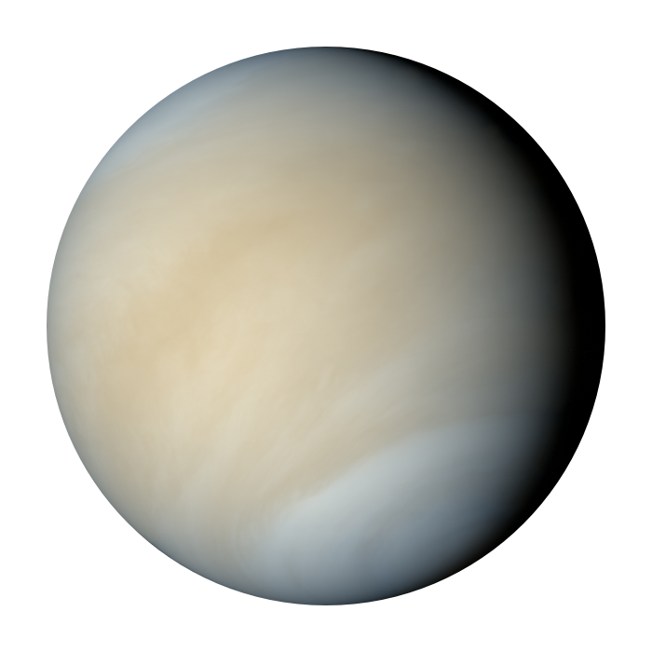
Venus | Facts
Distance from the Sun (Millions of Kilometres)
Length of 1 year
Length of 1 day
Diameter at the Equator
Circumference
Satellites
Surface Temperature
Gravity
Rotation

Slide 7
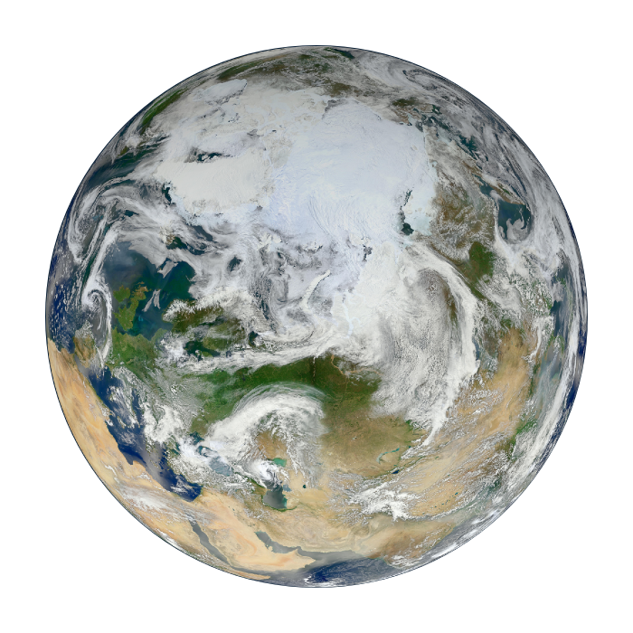
Earth | Facts
Distance from the Sun (Millions of Kilometres)
Length of 1 year
Length of 1 day
Diameter at the Equator
Circumference
Satellites
Surface Temperature
Gravity
Rotation

Slide 8
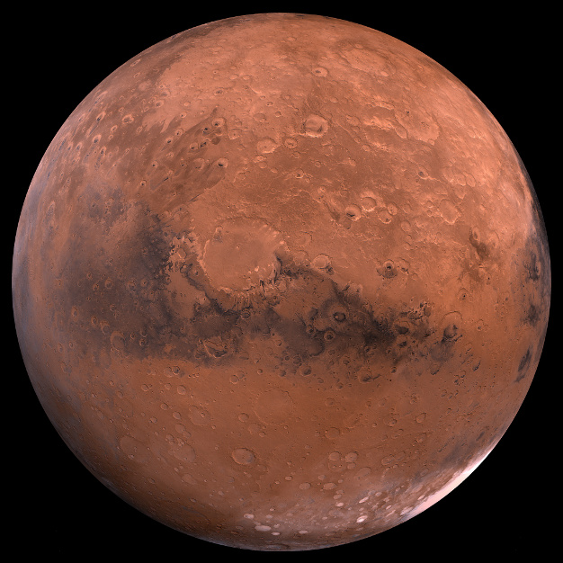
Mars | Facts
Distance from the Sun (Millions of Kilometres)
Length of 1 year
Length of 1 day
Diameter at the Equator
Circumference
Satellites
Surface Temperature
Gravity
Rotation

Slide 9
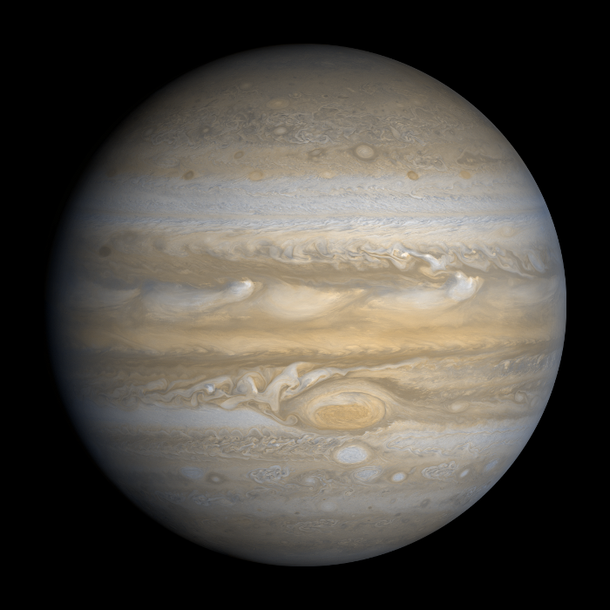
Jupiter | Facts
Distance from the Sun (Millions of Kilometres)
Length of 1 year
Length of 1 day
Diameter at the Equator
Circumference
Satellites
Surface Temperature
Gravity
Rotation

Slide 10
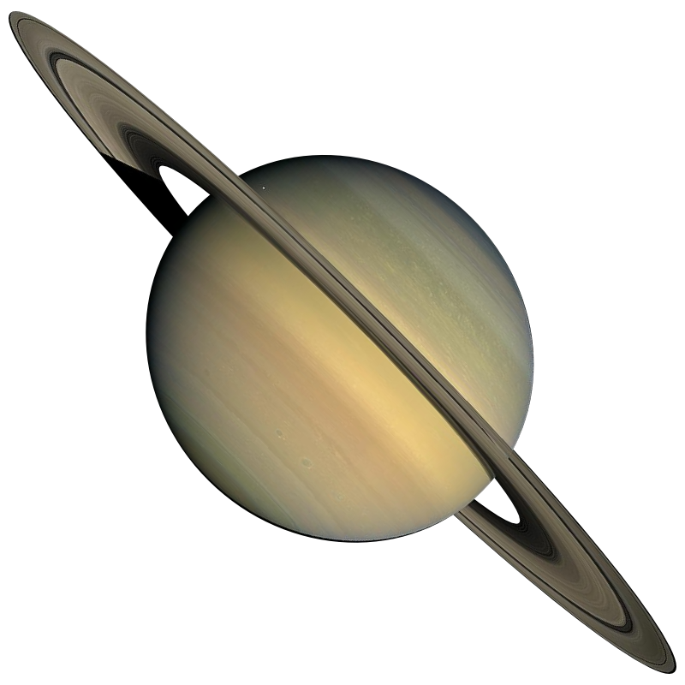
Saturn | Facts
Distance from the Sun (Millions of Kilometres)
Length of 1 year
Length of 1 day
Diameter at the Equator
Circumference
Satellites
Surface Temperature
Gravity
Rotation

Slide 11
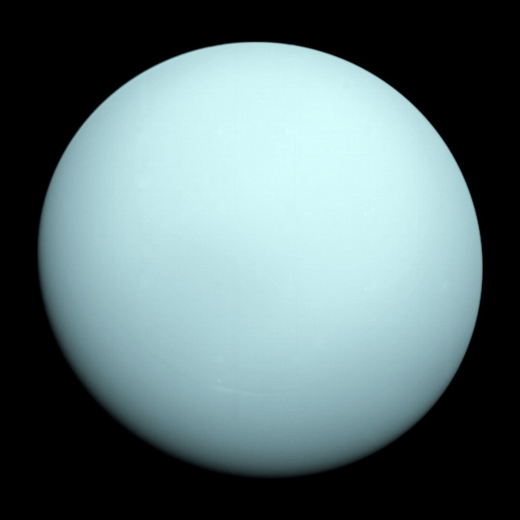
Uranus | Facts
Distance from the Sun (Millions of Kilometres)
Length of 1 year
Length of 1 day
Diameter at the Equator
Circumference
Satellites
Surface Temperature
Gravity
Rotation

Slide 12
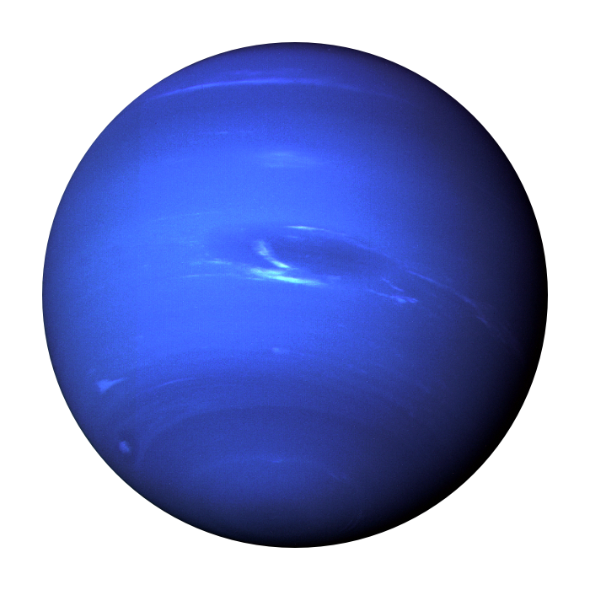
Neptune | Facts
Distance from the Sun (Millions of Kilometres)
Length of 1 year
Length of 1 day
Diameter at the Equator
Circumference
Satellites
Surface Temperature
Gravity
Rotation

Slide 13
 | Mercury | Venus | Earth | Mars | Jupiter | Saturn | Uranus | Neptune
Graviational Pull (N/Kg)
Astronaut’s mass in Kg |  |  | 80Kg
Astronaut’s weight in Newtons
Suppose an astronaut has a mass of 80Kg on earth….
Mass is measured in Kilograms (It doesn’t change with gravity)
Weight in Newtons = mass (Kg) x Gravitational pull (N/Kg)
Complete the table.

Slide 14
 | Mercury | Venus | Earth | Mars | Jupiter | Saturn | Uranus | Neptune
Length of 1 year
My Age in years
Calculate ‘Age last birthday x 365’ divided by length of 1 year for Mercury, Venus and Mars
Calculate ‘Age last birthday’ divided by length of 1 year for Jupiter, Saturn, Uranus and Neptune

Slide 15
 | Mercury | Venus | Earth | Mars | Jupiter | Saturn | Uranus | Neptune
Distance from the sun X 1 million Km | 58 | 108 | 150 | 228 | 778 | 1430 | 2870 | 5400
Time for light to travel
Speed = distance / time
Time = distance / speed
Speed of light = 300,000 km/s

Slide 16
ASTRONOMICAL distances
1 light year = distance travelled by light in one year
The speed of light = 300,000,000 metres/second
Number of seconds in one year = 365 x 24 x 60 x 60 approximately
= 31,536,000s
One light year = 300,000,000 x 365 x 24 x 60 x 60 metres
= 9,460,800,000,000,000m
= 9.46 x 10¹⁵ m in scientific notation

Slide 17
Measuring Gravity on earth
Practical Investigation : Measuring ‘g’, the gravitational force on Earth
What you need: Newton Balance (0-30N), Scales (0-3kg)
What you have to do:
Use a Newton Balance and a set of Kilogram
scales to compare the mass and weight of
everyday objects on planet earth, including a one
litre bottle of water.
The gravitational pull = g
= the number of Newtons / Kilogram
From your experiment ‘g’ = N/Kg
approximately.
Object | Mass in kgs | Weight in Newtons | Weight /mass (N/Kg)
1 litre bottle of water

